Slide 1

WAY TO ENTERPRISE
AWS
VTI ACADEMY
Author: duy.nguyenngoc1@vti.com.vn

Slide 2
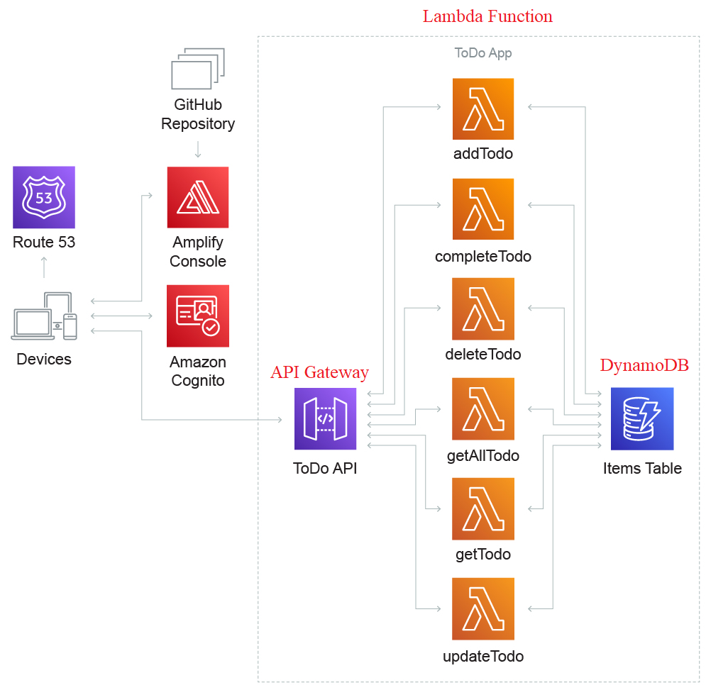
Serverless Architecture
Serverless does not mean there are no servers…
You don’t need to manage the server, just care about the core product, application business logic
No server management,
Flexible scaling
High availability
No idle capacity
Serverless == FaaS (Function as a Service)
Tutorial: https://aws.amazon.com/architecture/serverless

Slide 3
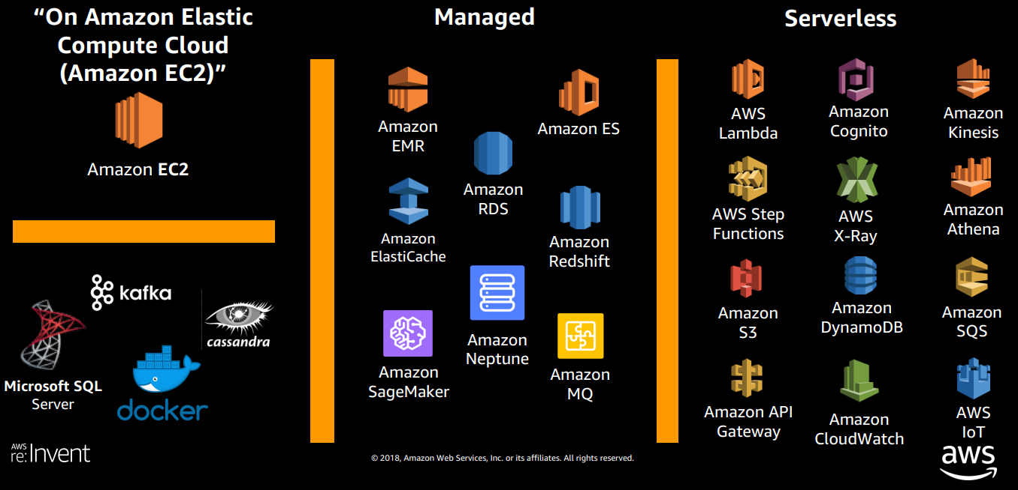
Serverless Architecture
Managed Service & Serverless Service

Slide 4
Serverless Architecture
Example 1: We want to create a mobile application with the following requirements
  Expose as REST API with HTTPS
  Serverless architecture
  Users should be able to directly interact with their own folder in S3
  Users should authenticate through a serverless service
  The users can write and read to-dos, but they mostly read them
  The database should scale, and have some high read throughput

Slide 5
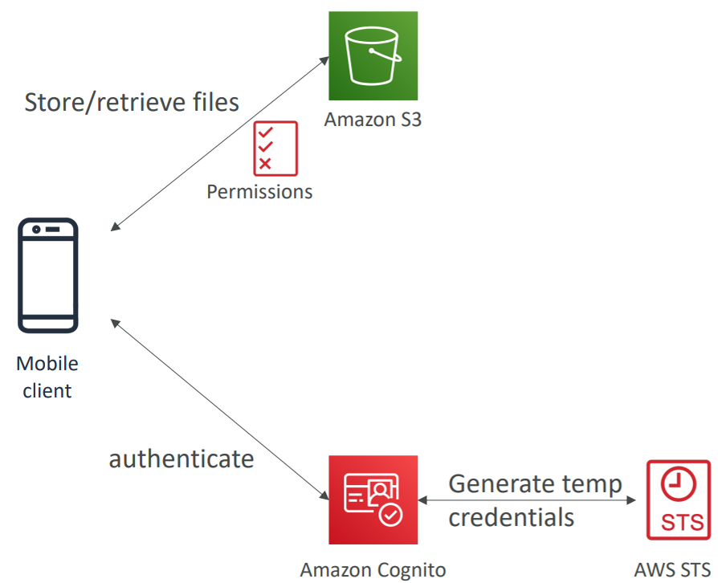
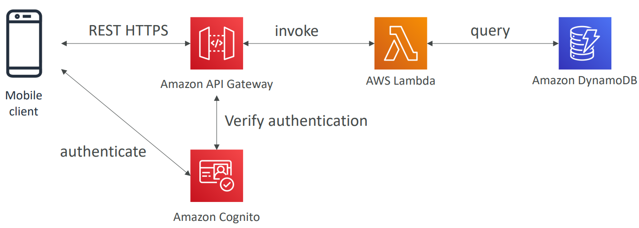
Serverless Architecture
REST API layer
(API Gateway + Lambda)
Giving users access to S3
(S3 + Cognito)

Slide 6
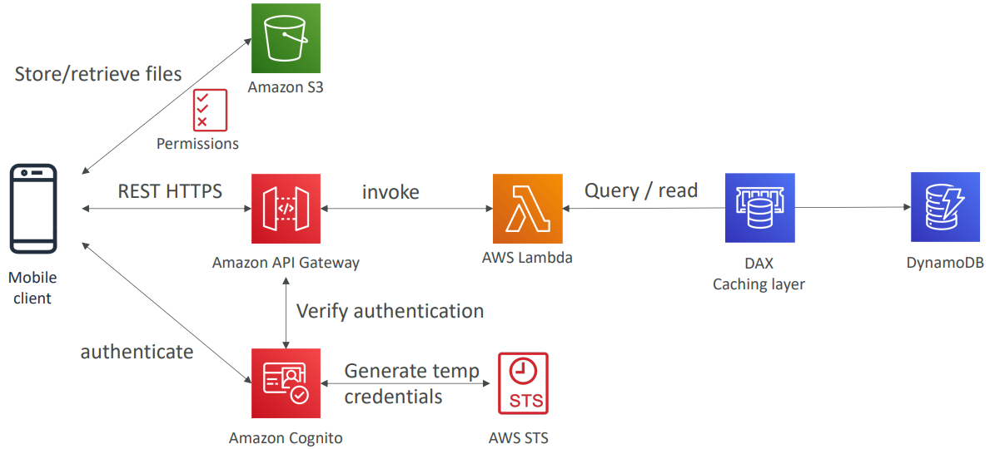
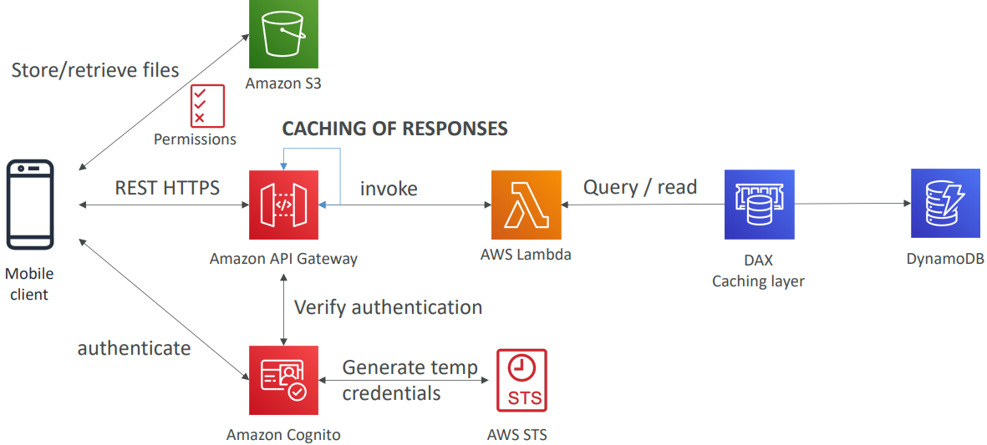
Serverless Architecture
High read throughput, static data
(DynamoDB + DAX)
Caching at the API Gateway

Slide 7
Serverless Architecture
  Summary
    Serverless REST API: HTTPS, API Gateway, Lambda, DynamoDB
    Using Cognito to generate temporary credentials with STS to access S3 bucket with restricted policy
    Caching the reads on DynamoDB using DAX
    Caching the REST requests at the API Gateway level
    Security for authentication and authorization with Cognito, STS

Slide 8
Serverless Architecture
Example 2: Serverless hosted website - MyBlog.com
  This website should scale globally
  Blogs are rarely written, but often read
  Some of the website is purely static files, the rest is a dynamic REST API
  Caching must be implement where possible
  Any new users that subscribes should receive a welcome email
  Any photo uploaded to the blog should have a thumbnail generated

Slide 9
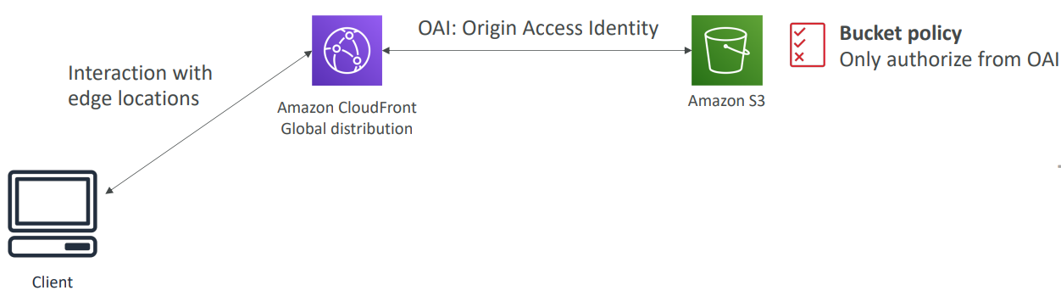
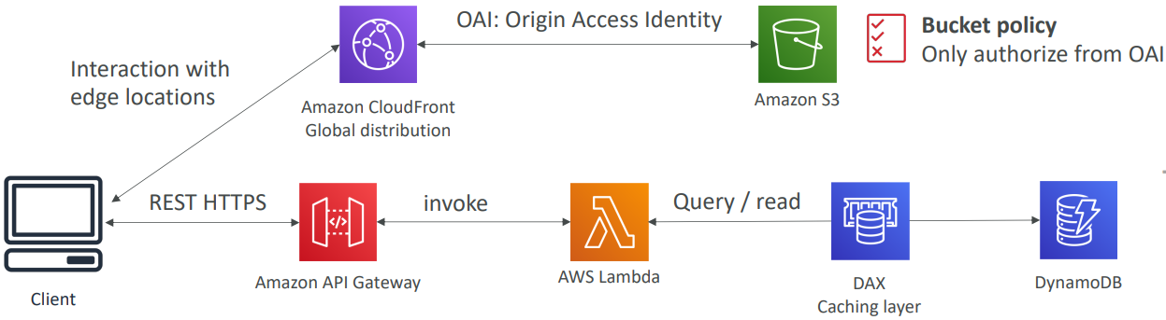
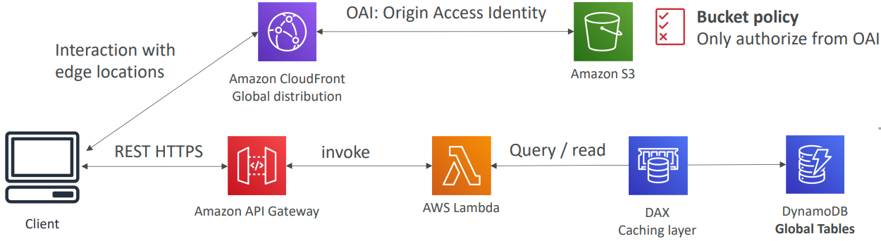
Serverless Architecture
Serving static content, globally
(S3 + Cloudfront)
Adding a public serverless REST API
(API Gateway + Lambda)
Global data
(DynamoDB with Global Tables + DAX)

Slide 10
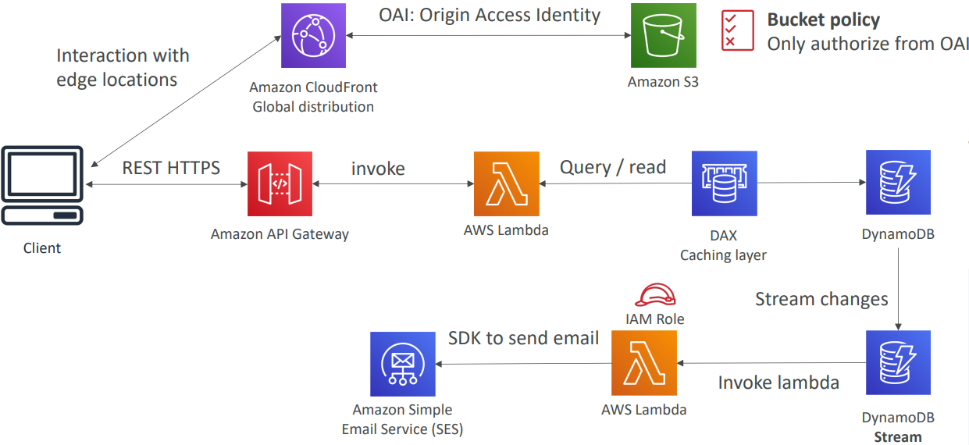
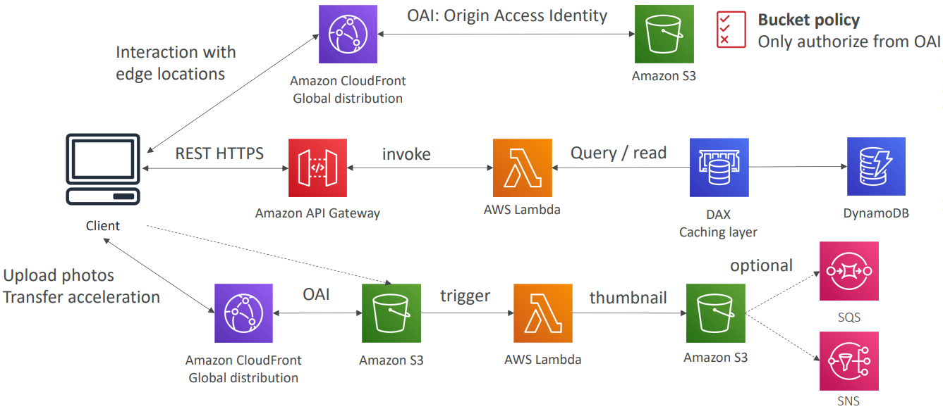
Serverless Architecture
User Welcome email flow
(trigger DynamoDB Stream + Lambda + SES)
Thumbnail Generation flow
(Cloudfront + S3 + Lambda)

Slide 11
Serverless Architecture
  Summary
    You’ve seen static content being distributed using CloudFront with S3 (setup OAI)
    The REST API was serverless, didn’t need Cognito because public
    You leveraged a DynamoDB Global table to serve the data globally (you could have used Aurora Global Database)
    You enabled DynamoDB streams to trigger a Lambda function
    The lambda function had an IAM role which could use SES
    SES was used to send emails in a serverless way
    S3 can trigger SQS / SNS / Lambda to notify of events

Slide 12
Serverless Architecture
Example 3: Distributing paid content
  You sell videos online and users have to paid to buy videos
  Each videos can be bought by many different customers
  You only want to distribute videos to users who are premium users
  You have a database of premium users
  Links we send to premium users should be short lived
  Your application is global
  You want to be fully serverless

Slide 13
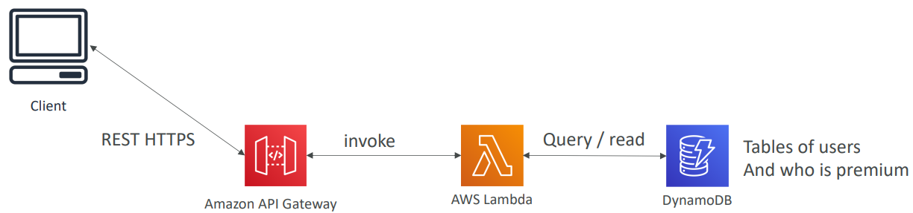
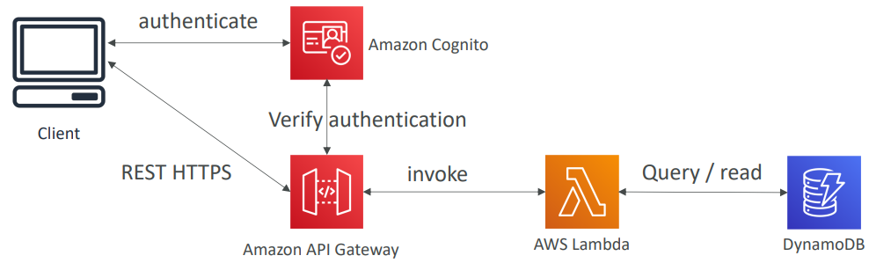
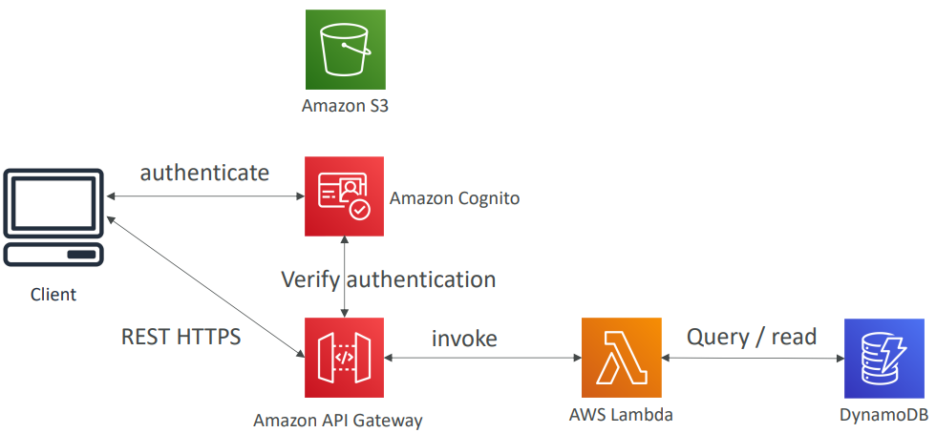
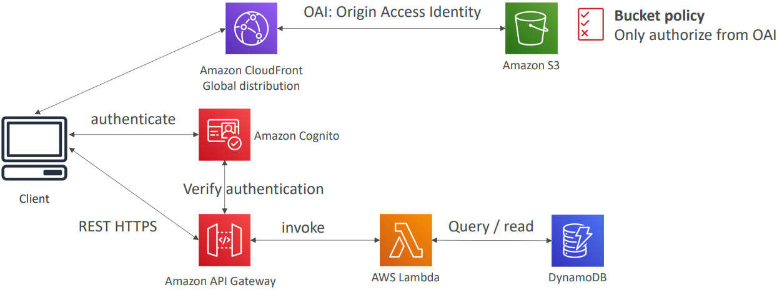
Serverless Architecture
Premium user service
(API Gateway + Lambda + DynamoDB)
Add authentication
(Cognito)
Add Videos Storage Service
(S3)
Distribute globally
(Cloudfront + S3)

Slide 14
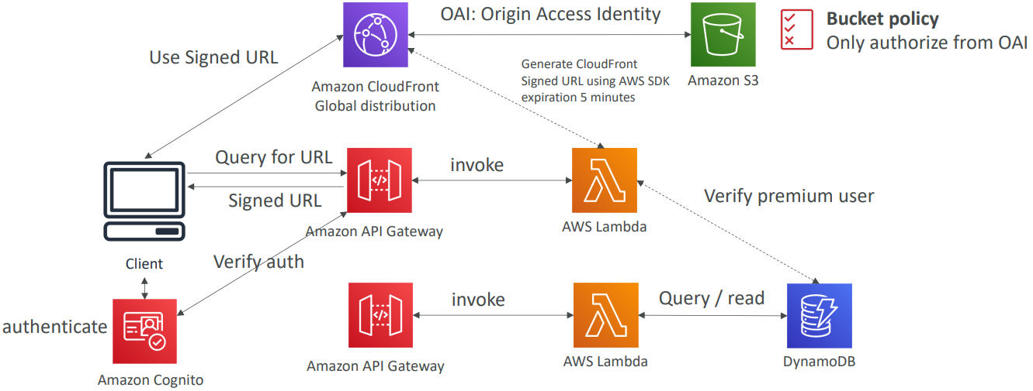
Serverless Architecture
Distribute Content only to premium users
(API Gateway + Lambda to generate Signed URL Cloudfront
Call Dynamo to check premium users)

Slide 15
Serverless Architecture
  Summary
    Cognito for authentication
    DynamoDB for storing users that are premium
    2 serverless applications: Premium User registration, CloudFront Signed URL generator
    Content is stored in S3 (serverless and scalable), integrated with CloudFront with OAI for security
    CloudFront can only be used using Signed URLs to prevent unauthorized users
    What about S3 Signed URL? They’re not efficient for global access

Slide 16
Serverless Architecture
Example 4: Big Data Ingestion Pipeline
  You want the ingestion pipeline to be fully serverless
  You want to collect data in real time
  You want to transform the data
  You want to query the transformed data using SQL interface
  The reports created using the queries should be in S3
  You want to load that data into a warehouse and create dashboards

Slide 17
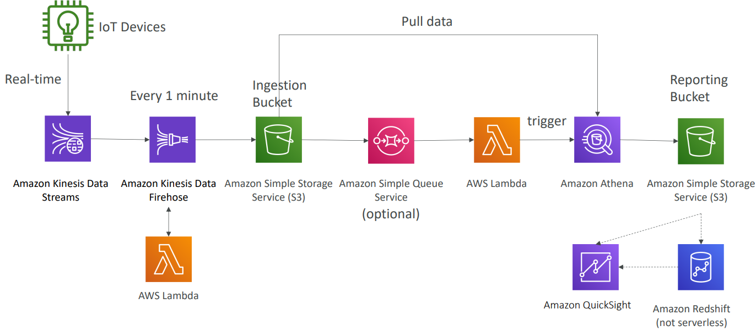
Serverless Architecture

Slide 18
Serverless Architecture
  Summary
    Kinesis is great for real-time data collection
    Firehose helps with data delivery to S3 in near real-time (1 minute)
    Lambda can help Firehose with data transformations before delivery to S3
    Amazon S3 can trigger notifications to SQS & Lambda can subscribe to SQS (You could have connect S3 to Lambda)
    Athena is a serverless SQL service and results are stored in S3
    The reporting bucket contains analyzed data and can be used by reporting tool such as AWS QuickSight, Redshift, …

Slide 19
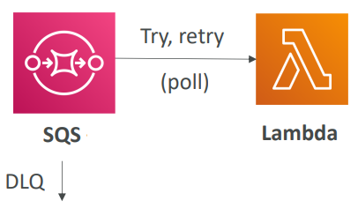
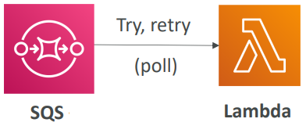
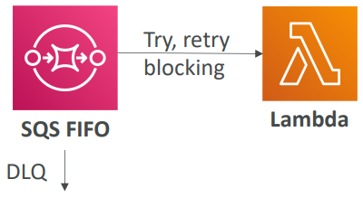
Serverless Architecture
Example 5: Event Processing
Standard SQS + Lambda
Add Dead Letter Queue to prevent infinite loop
FIFO SQS
Event Processing with SQS & Lambda

Slide 20
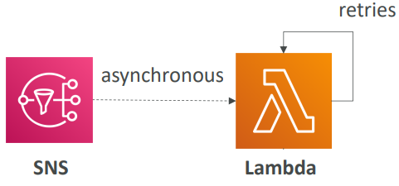
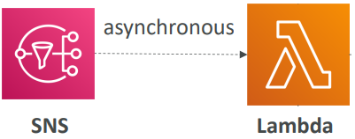
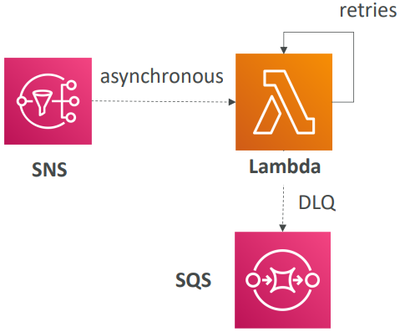
Serverless Architecture
SNS + Lambda
Check condition into Lambda to prevent omit error message
Add Dead Letter Queue for error message
Event Processing with SNS & Lambda & Dead Letter Queue

Slide 21
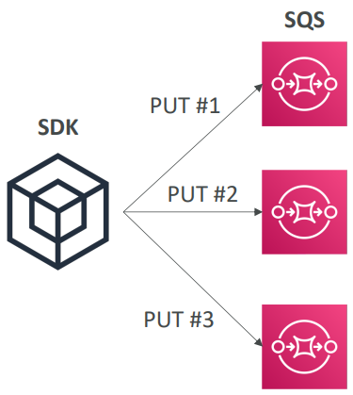
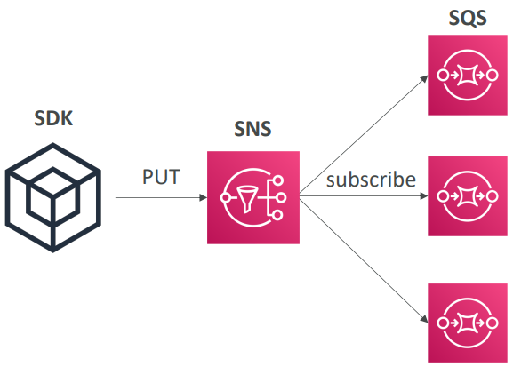
Serverless Architecture
Option 1
Option 2
(Recommended)
Deliver to multiple SQS

Slide 22
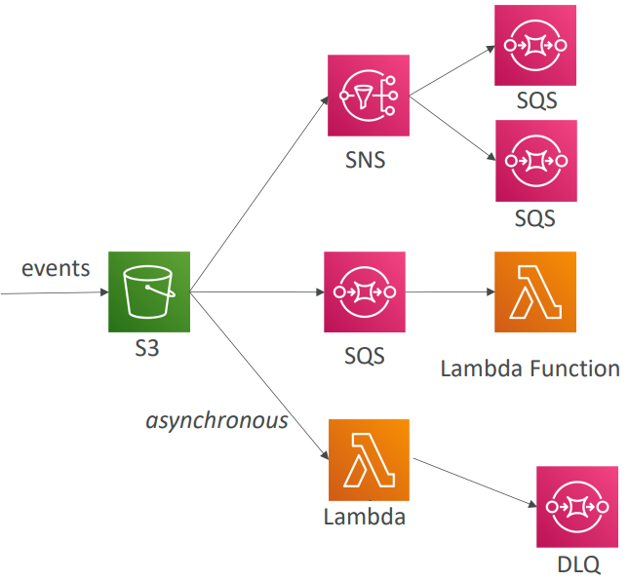
Serverless Architecture
  S3 Events
    S3:ObjectCreated, S3:ObjectRemoved, S3:ObjectRestore, S3:Replication…
    S3 event notifications typically deliver events in seconds but can sometimes take a minute or longer
    Use case: generate thumbnails of images uploaded to S3
S3 event can delivery to SNS, SQS, Lambda
Event Processing with S3 Event

Slide 23
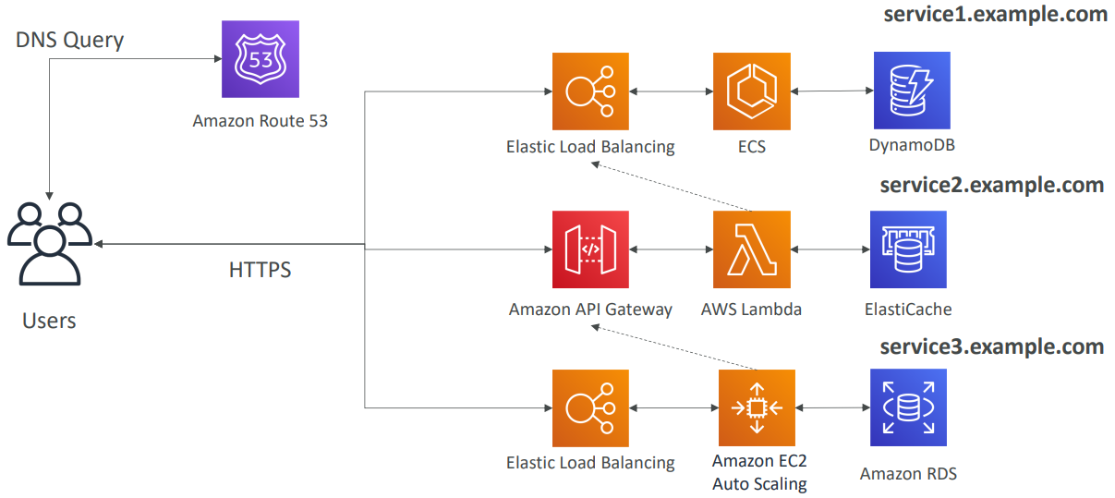
Serverless Architecture
Example 6: Microservices architecture
ECS service, API Gateway: next lesson

Slide 24
Serverless Architecture
  Summary
    Synchronous patterns: API Gateway, Load Balancers
    Asynchronous patterns: SQS, Kinesis, SNS, Lambda triggers (S3)

Slide 25
Q & A
Copyright © VTI Academy All Rights Reserved

